Slide 1
Structure: A Graphical Programming Language
Xiantao Cheng
2020-1-9

Slide 2
Why I call it graphical programming?
The only data type is graph vertex.
off
on
off
on
state
int light.state=
0
1
light
>>
>>

Slide 3
Why I call it graphical programming?
The only data type is graph vertex.
off
on
off
on
state
int light.state=
0
1
light
>> light -> +[turnOn](,light)
>> turnOn(light)

Slide 4
Why I call it graphical programming?
The only data type is graph vertex. And everything is for graph.
Data type: vertex, bool, int, double,…
Instructions: [del], [right_connect], [left_connect], ADD, SUB, MULTIPLY,…
Control flow: karma, if then, for each, while,…
Karma: the soul of Structure
Example: apple->on(apple,table)->table->+eat(,apple)
It’s different from arrow operator.

Slide 5




Work process of Structure
Normal point: stay as a part of graph
map
map
apple
apple
map
on
map
on
eat
Basic action point: call a basic operation
map
chair
map
table
Interpreted action point: call a function in library
>> apple->on(apple,table)->table->+eat(,apple)

Slide 6
Work process of Structure
Normal point: stay as a part of graph
apple
apple
on
on
[del]
Basic action point: call a basic operation
chair
table
Interpreted action point: call a function in library
>> apple->on(apple,table)->table->+[del](,apple)

Slide 7

Work process of Structure
Normal point: stay as a part of graph
apple
[del]
apple
core
on
on
[lt]
[eat]
Basic action point: call a basic operation
chair
table
Interpreted action point: call a function in library
>> apple->on(apple,table)->table->+[eat](,apple)

Slide 8
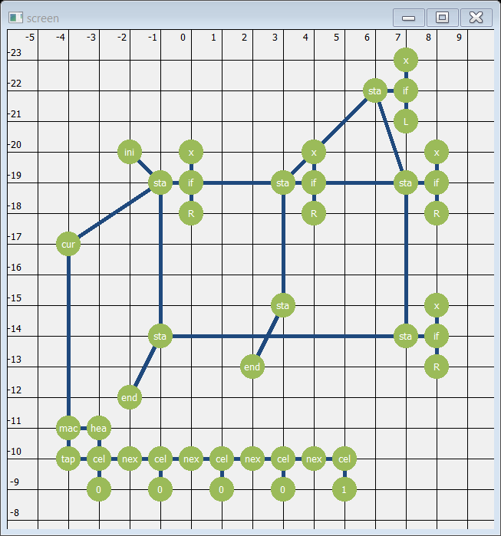
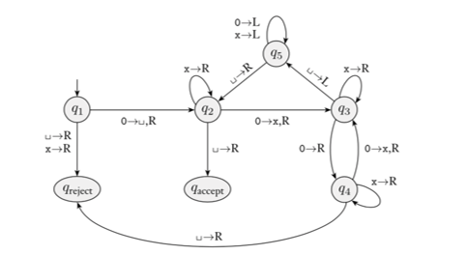
Example: Turing machine

Slide 9
Karma: a power expression for graph
Karma is pattern of graphs. A karma maps, in order, each node of it with vertices to find the wanted graph.
Nodes in a karma are connected by a relation(->, or =>) in order. The source is cause, and the target is effect.
apple -> on(apple, table) => cause => effect -> table -> …

Slide 10
Karma: a power expression for graph
Karma is pattern of graphs. A karma maps each node of it in order with vertices to find the wanted graph.
Nodes in a karma are connected by a relation(->, or =>) in order. The source is cause, and the target is effect.
A node has 5 states(initial, true, false, empty and all clear).
… -> node1 -> …
node2
node1
node3

Slide 11
Karma: a power expression for graph
Karma is pattern of graphs. A karma maps each node of it in order with vertices to find the wanted graph.
Nodes in a karma are connected by a relation(->, or =>) in order. The source is cause, and the target is effect.
A node has 5 states(initial, true, false, empty and all clear).
… -> node1
node2
node1
node3

Slide 12
Karma: a power expression for graph
Karma is pattern of graphs. A karma maps each node of it in order with vertices to find the wanted graph.
Nodes in a karma are connected by a relation(->, or =>) in order. The source is cause, and the target is effect.
A node has 5 states(initial, true, false, empty and all clear).
… -> node1 -> …
node2
node1
node3

Slide 13
Karma: a power expression for graph
Karma is pattern of graphs. A karma maps each node of it in order with vertices to find the wanted graph.
Nodes in a karma are connected by a relation(->, or =>) in order. The source is cause, and the target is effect.
A node has 5 states(initial, true, false, empty and all clear).
Interaction of two nodes depends on the relation between them.
node1 -> node2
node1 => node2

Slide 14
Karma: a power expression for graph
Karma is pattern of graphs. A karma maps each node of it in order with vertices to find the wanted graph.
Nodes in a karma are connected by a relation(->, or =>) in order. The source is cause, and the target is effect.
A node has 5 states(initial, true, false, empty and all clear).
Interaction of two nodes depends on the relation between them.
node1 -> node2
node1 => node2

Slide 15
Karma: a power expression for graph
Karma is pattern of graphs. A karma maps each node of it in order with vertices to find the wanted graph.
Nodes in a karma are connected by a relation(->, or =>) in order. The source is cause, and the target is effect.
A node has 5 states(initial, true, false, empty and all clear).
Interaction of two nodes depends on the relation between them.
node1 -> node2
node1 => node2

Slide 16

app
app
apple => on(apple, chair) -> chair
The apple not on a chair:

Slide 17
Karma V.S. Control flow
An apple on a table is eaten(by me):
apple -> on(apple, table) -> table -> +eat(,apple)
If there is an apple
If the apple is on a table
then eat the apple

Slide 18
Karma V.S. Control flow
An apple on a table is eaten(by me):
apple -> on(apple, table) -> table -> +eat(,apple)
If there is an apple
If the apple is on a table
then eat the apple
On a table, each apple is eaten(by me):

Slide 19
Karma V.S. Control flow
An apple on a table is eaten(by me):
apple -> on(apple, table) -> table -> +eat(,apple)
If there is an apple
If the apple is on a table
then eat the apple
On a table, each apple is eaten(by me):
On a table, no apple is not eaten(by me)

Slide 20
Karma V.S. Control flow
An apple on a table is eaten(by me):
apple -> on(apple, table) -> table -> +eat(,apple)
If there is an apple
If the apple is on a table
then eat the apple
On a table, each apple is eaten(by me):
On a table, no apple is not eaten(by me)
table => on(apple, table) -> apple => +eat(,apple)
Each = No + No!

Slide 21
[eat]
[eat]
cha
cha
rabbit => chair => on(apple, chair) -> apple -> +[eat](rabbit, apple)

Slide 22

[eat]
cha
cha
rabbit => chair => on(apple, chair) -> apple -> +[eat](rabbit, apple)

Slide 23
Calculate meaning of a sentence!
On a table, not each apple is eaten(by me):
On a table, no no apple is not eaten(by me).
On a table, an apple is not eaten(by me).
table -> on(apple, table) -> apple => eat(,apple)
On a table, each apple is not eaten(by me):
On a table, no apple is not not eaten(by me).
On a table, no apple is eaten(by me).
table => on(apple, table) -> apple -> eat(,apple)
On each table, each apple is eaten(by me):
There is no table, on which no no apple is not eaten(by me).
There is no table, on which an apple is not eaten(by me).
[] => table -> on(apple, table) -> apple => +eat(,apple)
Only, all, once … can also be expressed by karma similarly

Slide 24
[eat]
[eat]
[eat]
cha
cha
rabbit => chair -> on(apple, chair) -> apple => +[eat](rabbit, apple)
On each chair, each apple is eaten(by the rabbit).

Slide 25
Diversity of karma
apple -> on(apple, table) -> table: An apple is on a table.
apple => on(apple, table) -> table: An apple is not on any table.
table => on(apple, table) -> apple: On a table, there is no apple.
apple -> on(apple, table) => table: An apple is on something not table.
table -> on(apple, table) => apple: Something, not apple, is on a table.
table -> apple => on(apple, table): An apple is not on a table.
table => apple => on(apple, table): All apple is on a table.
[] => apple => on(apple, table) -> table: All apple is on table.
…
With only 3 nodes, there can be 48 karmas with 26 different meanings!

Slide 26
Conclusion
Advantages of Structure:
Easy to operate on a very complex graph.
Karma is a powerful tool, which is compact and expressive.
Meaning of karma is directly related to natural language.
Disadvantage of Structure:
Very very slow.

Slide 27
Future works
Structure2English:
English sentence =>> AST =>> karma
Compiler for Structure

